Slide 1
Session Based Test Management
QUEST 2012
April 30 - May 4
Notes:
1:00 PM - 4:30 PM

Slide 2
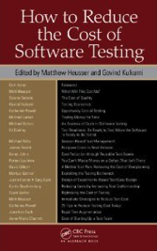
Partner, DeveloperTown | www.DeveloperTown.com
Past President, Association for Software Testing | www.AssociationForSoftwareTesting.org
Articles and Blogs | www.MichaelDKelly.com
Author of the chapter on “Session Based Test Management” in the book How to Reduce the Cost of Software Testing

Slide 3
Exploratory Testing
Notes:
Mechanics…
What is ET?
What’s someone doing?

Slide 4
“Simultaneous learning, test design, and test execution.”
- James Bach
Notes:
Mechanics…
What is ET?
What’s someone doing?

Slide 5
pure scripted
fragmentary test cases (scenarios)
freestyle exploratory
vague scripts
charters
roles
-image from Jon Bach
Notes:
approach
alignment with the agile manifesto

Slide 6
the tester, the way they work,
and their ability to work in the future, is
as important as
the product being tested

Slide 7
Focus on dealing with uncertainty

Slide 8
Exploratory Skills and Tactics
Self-Management
Developing Ideas
Examining the Product
Chartering
Refocusing
Branching and Backtracking
Alternating
Recording and Reporting
Resourcing
Modeling
Questioning
Generating and Elaborating
Overproduction and Abandonment
Abandonment and Recovery
Collaborating
Interacting with the product
Observing
Applying tools
Conjecturing
Modeling
http://www.satisfice.com/articles/et-dynamics.pdf

Slide 9
Session Based Test Management
(the building blocks)
Notes:
Mechanics…
What is ET?
What’s someone doing?

Slide 10
charters

Slide 11
charters
time-boxed

Slide 12
charters
time-boxed
session notes

Slide 13
charters
time-boxed
session notes
debriefs

Slide 14
charters
time-boxed
session notes
debriefs
team prioritization

Slide 15
charters
time-boxed
session notes
debriefs
team prioritization
ad-hoc test documentation
Notes:
ad hoc does not mean unstructured

Slide 16
charters
time-boxed
session notes
debriefs
team prioritization
ad-hoc test documentation
ad-hoc test automation
Notes:
ad hoc does not mean unstructured

Slide 17
charters
time-boxed
session notes
debriefs
team prioritization
ad-hoc test documentation
ad-hoc test automation
dynamic metrics and reporting

Slide 18
Session Based Test Management
(a deeper look)
Notes:
Mechanics…
What is ET?
What’s someone doing?

Slide 19
Charters
(separating the real testers from the posers)
Notes:
Mechanics…
What is ET?
What’s someone doing?

Slide 20
“One of the most difficult aspects of software testing is coming up with good test ideas. It doesn't matter how you're doing your testing: scripted vs. exploratory, manual vs. automated, or performance vs. functional.”

Slide 21
The basic work unit in session-based test management is the session
The sessions are organized around test charters
Each session is time-boxed (typically 45 to 60 minutes)
The charter for each session often outlines the basic testing mission

Slide 22
So when you look at a list of 10 charters, you should see 10 distinct testing missions equating to around eight to 10 hours of heads-down testing.

Slide 23
What am I suppose to be doing…
I ran out of time…
I ran out of test ideas…

Slide 24
Test the portal for reporting accuracy.
Which reports?
What do you mean by accuracy?
Test reports X, Y, and Z for errors related to start and end time selection criteria, summing, totaling, and rounding.
Notes:
Drill down to specifics
Take an additional 30 to 120 seconds

Slide 25
Test feature X
Stress test feature X
Performance test feature X
What’s the difference?
Notes:
Compare your missions
If you can’t tell one mission from another, you’ve not done a good enough job defining it

Slide 26
My mission is to test <insert risk here> for <insert coverage here>.

Slide 27
Kiwanis International App :: Charters
Test for boundary related issues related to projects
Test for boundary related issues related to project reports
Test for deliverability related issues related to project emails
Test for data quality issues with clubs available on the app
Test for data accuracy issues related to calculations on project reports
Test for data accuracy issues related to calculations on service and fundraising summary stats
Test for data accuracy issues related to Piggy Bank commitment calculations
Perform basic link validation for items in the news feed
Perform a copy review of the various descriptive dialogs in the app looking for typos and grammar issues
Test for performance related issues related to mapping capabilities
Stress test the application to identify conditions that crash the app

Slide 28
Walk your charters quickly as a team
Use thumb voting to see if there is agreement around clarity and scope
The particularly contentious charters will lead the team to discussion and debate

Slide 29
In Your Charter:
When you charter your tests, include polarities explicitly in your mission. This practice is particularly effective for shorter test charters.
Testing vs. Touring
Feature vs. Feature
Requirement vs. Requirement
When you charter, use the polarities to help you identify new charter ideas. This practice feeds overproduction and abandonment.
While Chartering:
Individual Tests vs. General Lab Procedures
Coverage vs. Oracles
Lab Conditions vs. Field Conditions

Slide 30
Mnemonics
Application Touring: FFC CUTS VIDS
Session Notes: MCOASTER
Coverage: SFDPOT
Quality Criteria: CRUSSPICSTMPL
Oracles: HICCUPPS

Slide 31
Session Notes
(bringing order from chaos)
Notes:
Mechanics…
What is ET?
What’s someone doing?

Slide 32
Tools
Notepad and Word templates
Moleskins and composition books
Wikis and ticketing systems
Mind mapping tools
Desktop recording tools
VM session management tools
Test automation tools
Server monitoring and logging
Notes:
Preserving what you did

Slide 33
Immediately after your testing, take your notes and answer the following questions using only your notes:
What was I testing?
Why was I testing?
How did I test it?
What data did I use?
Where did I test it?
What did I find?
What did I not test?
What, if I had it, would allow me to do more or better testing?

Slide 34
MCOASTER
Audience
Techniques
Risk
Mission
Coverage
Obstacles
Environment
Status

Slide 35
Sometimes polarities can help structure your notes:
Warming up vs. Cruising vs. Cooling down
Careful vs. Quick
Data gathering vs. Data analysis
Lab conditions vs. Field conditions
Current version vs. Old versions
Feature vs. Feature
Requirement vs. Requirement
Coverage vs. Oracles
Testing vs. Touring
Individual tests vs. General lab procedures and infrastructure
Playful vs. Serious

Slide 36
Tagging items for follow-up
I regularly tag the following:
bugs or issues for isolation
possible new charters
open questions
tasks for automation
tasks for documentation
setup, testing, investigation

Slide 37
Session Debriefs
(making meaning from the data and the art of giving feedback)
Notes:
Mechanics…
What is ET?
What’s someone doing?

Slide 38
Debriefs are about
making sense
of all the data
Notes:
Developing the big picture
Filling in project holes

Slide 39
Debriefs are a time to
prioritize real-time,
make project adjustments,
and assign tasks
Notes:
Assigning work
Changing priorities
Changing scope

Slide 40
Debriefs are with people

Slide 41
Managing Priorities
(you can’t test everything)
Notes:
Mechanics…
What is ET?
What’s someone doing?

Slide 42
A - This charter must be executed before I know enough about the feature to make a recommendation related to production. Or more simply, "We need to run this charter."
B - This charter represents a good set of test ideas, which could uncover issues that might prevent us from going to production. Or more simply, "If we have time, we should run this charter."
C - This charter represents a set of test ideas that might be valuable at some point. Or more simply, "It's a test, and we could run it, but likely there are better uses of our time.”

Slide 43
Group Prioritization vs. Real-Time Prioritization
As a group I might:
Thumb vote on charter level.
Collaboratively force-rank A-level charters.
After I execute any given charter I might:
Add some number of new A-, B- or C-level charters.
Reprioritize existing A-, B- or C-level charters (up or down).
Make no changes.

Slide 44
Mapping Priorities to Coverage
A-, B-, and C-level charter priorities:
A - We need to run this charter.
B - We should run this charter if we have time.
C - We could run this charter, but there are likely better uses of our time.
Low-tech testing dashboard (Bach)
0 - We have no good information about this area.
1 - We've done a sanity check of major functions using simple data.
2 - We've touched all functions with common and critical data.
3 - We've looked at corner cases using strong data, state, error, or stress testing.

Slide 45
Metrics and Reporting
(visibility of project risk and tracking progress)
Notes:
Mechanics…
What is ET?
What’s someone doing?

Slide 46
Track velocity instead of percent complete

Slide 47
Hypothetical Project
 | Charters created | Charters executed | Remaining charters
Day 1 | 10 | 9 | 20
Day 2 | 8 | 8 | 21
Day 3 | 9 | 7 | 21
Day 4 | 6 | 8 | 23
Day 5 | 5 | 7 | 21
Day 6 | 7 | 9 | 19
Day 7 | 4 | 6 | 17
Day 8 | 5 | 7 | 15
Day 9 | 3 | 8 | 13

Slide 48
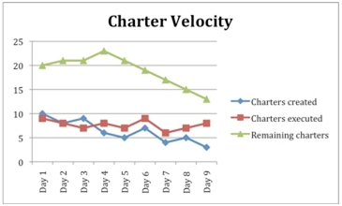

Slide 49
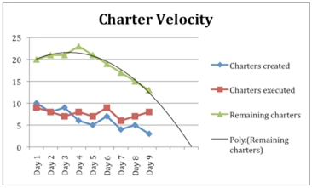

Slide 50
Some other SBTM metrics
Percentage of session time spent setting up for testing
Percentage of session time spent testing
Percentage of session time spent investigating problems

Slide 51
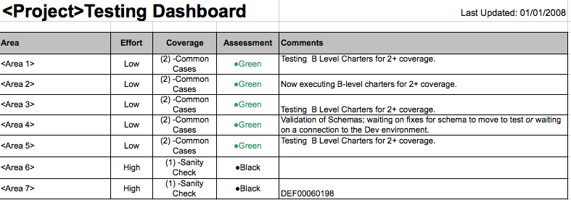
Low-Tech Testing Dashboard

Slide 52
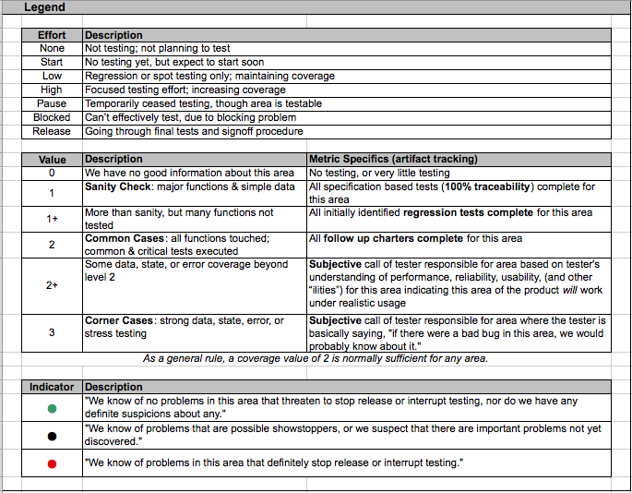

Slide 53
Session Based Test Management
(in practice)
Notes:
Mechanics…
What is ET?
What’s someone doing?

Slide 54
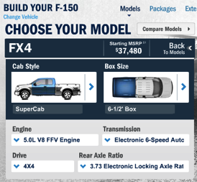
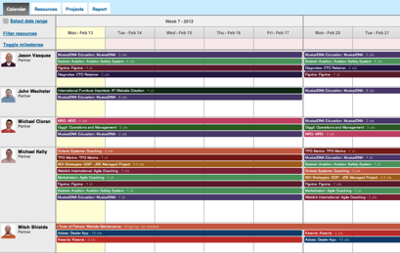
Pick a project
Ford Vehicle Builder
Blueprint
http://ford.com/
Build your F-150
http://blueprintlog.com/
Online resource planning tool

Slide 55
Google Spreadsheet for charter tracking
https://docs.google.com/spreadsheet/ccc?pli=1&key=0AqydatMd6PtbdGtDR2JoVkxOQzBnc0JjX1lDMEJwYlE#gid=0
-or-
http://bit.ly/y8bs8L

Slide 56
The Process
Form teams

Slide 57
The Process
Form teams
Generate your first pass of charters

Slide 58
The Process
Form teams
Generate your first pass of charters
Prioritize your charters

Slide 59
The Process
Form teams
Generate your first pass of charters
Prioritize your charters
Test (take detailed notes)

Slide 60
The Process
Form teams
Generate your first pass of charters
Prioritize your charters
Test (take detailed notes)
Debrief

Slide 61
The Process
Form teams
Generate your first pass of charters
Prioritize your charters
Test (take detailed notes)
Debrief
Update your charter listing

Slide 62
The Process
Form teams
Generate your first pass of charters
Prioritize your charters
Test (take detailed notes)
Debrief
Update your charter listing
Track progress

Slide 63
The Process
Form teams
Generate your first pass of charters
Prioritize your charters
Test (take detailed notes)
Debrief
Update your charter listing
Track progress
Repeat

Slide 64
Tutorial Checkout
Notes:
Mechanics…
What is ET?
What’s someone doing?

Slide 65
Reading Materials
Bach, James. "Exploratory Testing Explained." First published as a chapter in The Test Practitioner, 2002. Available online at: http://www.satisfice.com/articles/et-article.pdf
Bach, James and Jon Bach. "Exploratory Testing Dynamics." Available online at: http://www.satisfice.com/articles/et-dynamics.pdf
Bach, Jon. "Session Based Test Management." First published in Software Testing and Quality Engineering, November 2000. Available online at: http://www.satisfice.com/articles/sbtm.pdf
Bach, James. "A Low-Tech Testing Dashboard." Presented at STAREast, 1999. Available online at: http://www.satisfice.com/presentations/dashboard.pdf
Bach, Jon. "How to Manage and Measure Exploratory Testing." Quardev, 2006. Available online at: http://www.quardev.com/content/whitepapers/how_measure_exploratory_testing.pdf
Petty, Kenn. "Reflections on the Use of Session-Based Exploratory Testing As the Primary Test Methodology for Software in an Agile Environment." Presented at the Indianapolis Workshops on Software Testing, April 2005. Available online at: http://www.indianapolisworkshops.com/docs/Reflections_on_the_use_of_Session-Based_Exploratory_Testing_in_an_Agile_Environment.doc
Petty, Kenn. "Transitioning from Standard V&V to Rapid Testing Practices in a Chaotic Project Environment." Presented at the Conference of the Association for Software Testing, 2007. Available online at: http://www.associationforsoftwaretesting.org/documents/Kenn_Petty_Transitioning_from_Standard_V&V_to_Rapid_Testing_Practices.pdf
Wood, Bill and David James. "Applying Session-Based Testing to Medical Software." Medical Device and Diagnostic Industry Magazine, May 2003. Available online at: http://www.mddionline.com/article/applying-session-based-testing-medical-software
Kelly, Michael. “The benefits of exploratory testing in agile environments.” SearchSoftwareQuality.com, 2009. Available online at: http://searchsoftwarequality.techtarget.com/tip/0,289483,sid92_gci1350741,00.html
Kelly, Michael. “Using session-based test management for exploratory testing.” SearchSoftwareQuality.com, 2009. Available online at: http://searchsoftwarequality.techtarget.com/tip/0,289483,sid92_gci1352925_mem1,00.html
Kelly, Michael. “Using session-based test management for exploratory testing coverage problems.” SearchSoftwareQuality.com, 2009. Available online at: http://searchsoftwarequality.techtarget.com/tip/0,289483,sid92_gci1355475_mem1,00.html
Kelly, Michael. “Solving problems with session-based test management.” SearchSoftwareQuality.com, 2009. Available online at: http://searchsoftwarequality.techtarget.com/tip/0,289483,sid92_gci1355815_mem1,00.html

